Slide 1


Session 5: Hash Tables, Hash functions and Heap.

Slide 2

Agenda
Quick Recap.
Hash Tables.
Hash functions.
Unordered Maps and unordered Set.
Practice Problem
Heap.
Priority queue.
Practice Problem Vol.2

Slide 3
Powerful resources
GeeksforGeeks Data structures section: https://www.geeksforgeeks.org/data-structures/?ref=shm
Visualization tool for Data structures: https://www.cs.usfca.edu/~galles/visualization/Algorithms.html
CS50 Data Structures: https://www.youtube.com/watch?v=2T-A_GFuoTo&t=80s
Time Complexity Cheat Sheet: https://www.bigocheatsheet.com/
Hashing Data Structure:: https://www.geeksforgeeks.org/hashing-data-structure/

Slide 4
What is better for random access?
BSTs.
Linked Lists.
Arrays.

Slide 5
Which is better for searching a value?
BSTs.
Linked Lists.
Arrays.

Slide 6
Time complexity of finding a value in an unsorted array?
O(1)
O(N)
O(log(N))

Slide 7
Time complexity of finding a value in an balanced BST?
O(1)
O(N)
O(log(N))

Slide 8
What takes less memory?
Linked Lists
BSTs
Arrays

Slide 9
First in First out
Arrays
Stack
Queue

Slide 10
Last in First out
Arrays
Stack
Queue

Slide 11
The art of data structures attendance system.
We want to build a solution so we can check if someone coming to attend registered in the form or not. Let us solve this problem with our data structures knowledge so far.

Slide 12
Naïve array solution O(n)
List of
1- Ahmed
2- Somia
3- Ayman
4- Farah
5- Hosam
6- Mahmoud
7- Mai
8- Maria
9- Martina
10- Mehrael
11- Menna
12- Omar
13- Rowida
14- Shahd
registered
15- Youssef
16- Ziad
17- Abdelrahman
18- Abdullah
19- Nariman
20- Nada
21- Yara
22- Marina
23- Sara
24- Mohamed
25- Abanob
26- Andrew
27- Seif
28- Esmaeel

Slide 13
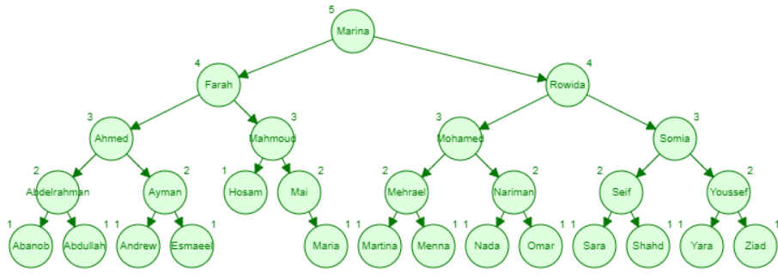
BST Log(n)
Visualize Here!

Slide 14
Can we do better?
While log(N) is very good and there is a huge difference between O(N) and O(log(N)).
Can we maybe get to O(1)?

Slide 15
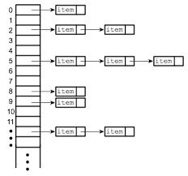
Combining Data Structures
So far, we talked about each data structure separately. But what if we tried to combine data structures so we can get the best of both worlds.
Array of Linked Lists

Slide 16
Introducing Hash tables
It’s basically an Array of Linked Lists. Benefiting from the O(1) Random access of the array and the dynamism of the Linked Lists.
Hash tables is one of the most important and most used Data Structures. Why?
Because It allows to associate keys with values in a very effective way.
More here

Slide 17
Associating keys with values
Associating keys with values is a very common thing. Either in coding problems or in software development. The examples are limitless.
Some examples:
Key → Value
1- University ID → Grades
2- Username → Password
3- National ID → Full name
4- Country → Capital city
5- Barcode → Product

Slide 18
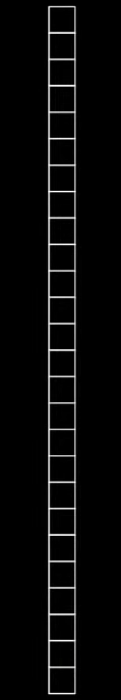
0
1
2
3
4
5
6
7
8
9
10
11
12
13
14
15
16
17
18
19
20
21
22
23
24
25
Abdelrahman
Esmaeel
Farah
Hosam
We are taking the first letter of each name, matching it to its index.
Now it takes only O(1) to find someone!
Mai
Nada
Omar
Rowida
Somia
Youssef
Ziad

Slide 19
0
1
2
3
4
5
6
7
8
9
10
11
12
13
14
15
16
17
18
19
20
21
22
23
24
25
Abdelrahman
Ahmed
Abdallah
Ayman
Abanob
Esmaeel
Andrew
Farah
Collisions!
It’s no longer O(1) :(
A collision occurs when two keys are hashed to the same index in a hash table.
Hosam
Mai
Mahmoud
Maria
Martina
Meharel
Nada
Nariman
Omar
Menna
Marina
Rowida
Somia
Shahd
Sara
Seif
Mohamed
Youssef
Yara
Ziad

Slide 20
What can we do?
Maybe instead of just looking at the first letter. We look at the first and second letter. So we have less collisions.
Still it wouldn’t be good enough. It will certainly be better than just checking the first letter alone, but Imagine all the people with the name mohamed colliding. Also note the memory consumption.

Slide 21
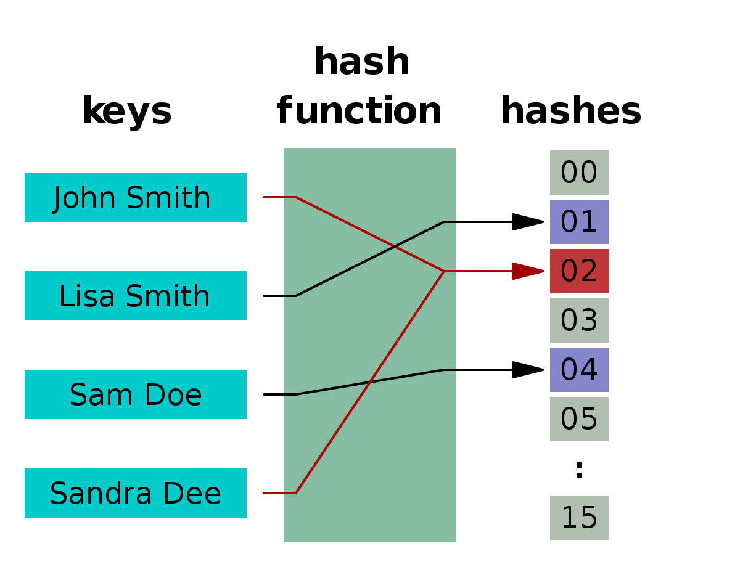
Hashing functions
A function that converts a given big phone number to a small practical integer value. The mapped integer value is used as an index in hash table. In simple terms, a hash function maps a big number or string to a small integer that can be used as index in hash table.
More here

Slide 22
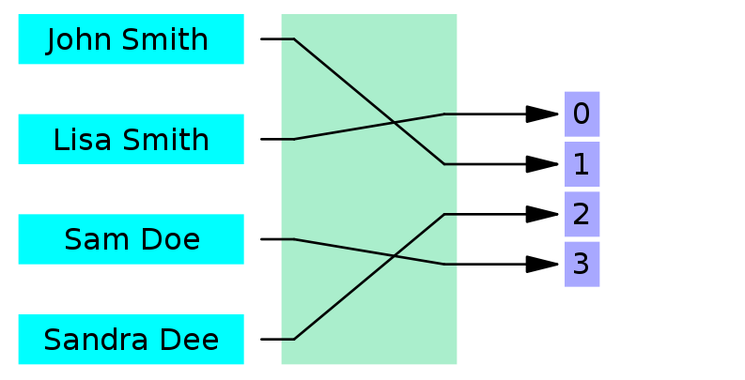
What is a good hashing function?
Should uniformly distribute the keys (Each table position equally likely for each key)
Note: A perfect hashing function doesn’t exist.

Slide 23

We have all done hashing before
If you separate your clothes. Putting pants in one place. T-Shirts in one place. Socks in one place. Then you have done hashing. now when you are looking for a shirt. You don’t have to search through all your clothes. You just search in the place you places your shirts.

Slide 24
We need a better hashing function.
Fortunately, We don’t have to write it ourselves. We can rely on Built in Libraries. you will rarely come across a scenario where you need to implement your own hashing functions, but understanding hash tables and hash functions help us in order to not misuse the built in ones. but it consumes more memory.

Slide 25
Which way is better to hash
a phone number?
By first three digits.
By last three digits.

Slide 26
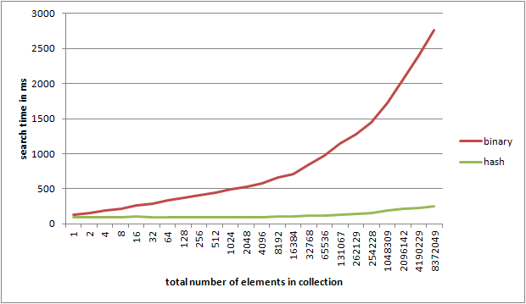
Hash Tables vs BST
Hash Tables has an average case time of O(1) and Worst case time of O(N). While Balanced BST has Worst case of log(N).

Slide 27
Then why even use BSTs?
We can get all keys in sorted order by just doing Inorder Traversal of BST.
BSTs are easy to implement compared to hashing, we can easily implement our own customized BST. To implement Hashing, we generally rely on libraries provided by programming languages.
With Self-Balancing BSTs, all operations are guaranteed to work in O(Logn) time. But with Hashing, Θ(1) is average time and some particular operations may be costly, especially when table resizing happens.
More here

Slide 28
Hash tables in STLs
unordered_set<int> intSet;
unordered_map<int,int> u_map;
Takes O(1) on average and O(n) as worst case.
Now we can finally found the optimal solution to finding whether or not someone was registered in the course.
Very simple to use!
Setting a value → u_map[key] = value;
getting a value → cout << u_map[key];
More here

Slide 29
Iterators
unordered_map<int,int>::iterator it;
for (it = x.begin();it!=x.end();it++)
{
cout << it->first << endl;
cout << it->second << endl;
}
or
for (auto it : u_map)
{
cout << it.first << endl; //Key
cout << it.second << endl; //Value
}

Slide 30
A problem to solve
Given N integers. Print integers repeated K or more times. without duplications and in no specific order.
Sample Input:
N: 5
X: [1,1,2,3,4]
K: 2
Output:
1
Sample Input:
N: 9
X: [1,1,1,2,4,3,4,5,4]
K: 3
Output:
1,4

Slide 31
Heaps
A Heap is a special Tree-based data structure in which the tree is a complete binary tree. Generally, Heaps can be of two types:
Max-Heap: In a Max-Heap the key present at the root node must be greatest among the keys present at all of it’s children. The same property must be recursively true for all sub-trees in that Binary Tree.
Min-Heap: In a Min-Heap the key present at the root node must be minimum among the keys present at all of it’s children. The same property must be recursively true for all sub-trees in that Binary Tree
More on Heaps.

Slide 32
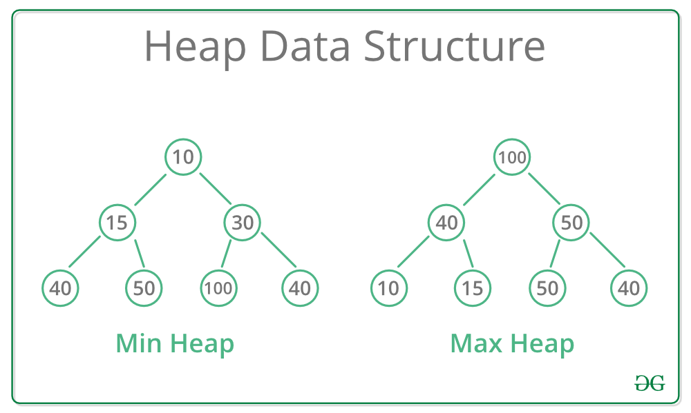

Slide 33
6 elements
9 elements
1
1
2
3
2
3
4
5
6
4
5
6
7
8
9

Slide 34
Why Heap?
Heap is a useful data structure when it is necessary to repeatedly remove the object with the highest (or lowest) priority
getting min or max → O(1)
Insertion → log(N)
Remove min or max → log(N)
Visualize here

Slide 35
Applications of Heap
1) Heap Sort: Heap Sort uses Binary Heap to sort an array in O(nLogn) time.
2) Graph Algorithms: The priority queues are especially used in Graph Algorithms like Dijkstra’s Shortest Path and Prim’s Minimum Spanning Tree.
3) Many problems can be efficiently solved using Heaps.
More here

Slide 36
Heaps in STLs
priority_queue<int> pq; → Max_Heap
priority_queue<int, vector<int>, greater<int> > pq; → Min_Heap
Top(): Returns the top most element of the queue.
size(): function returns the size of the queue.
pop(): function removes the first element of the queue.
push(g): function adds the element ‘g’ at the end of the queue.

Slide 37
Largest K elements
Given N integers. Print The largest K elements from Largest to smallest.
Sample Input:
N: 5
X: [14,10,7,3,15]
K: 2
Output:
[15,14]
Sample Input:
N: 8
X: [1,2,3,4,5,6,6,7]
K: 4
Output:
[7,6,6,5]

